Slide 1
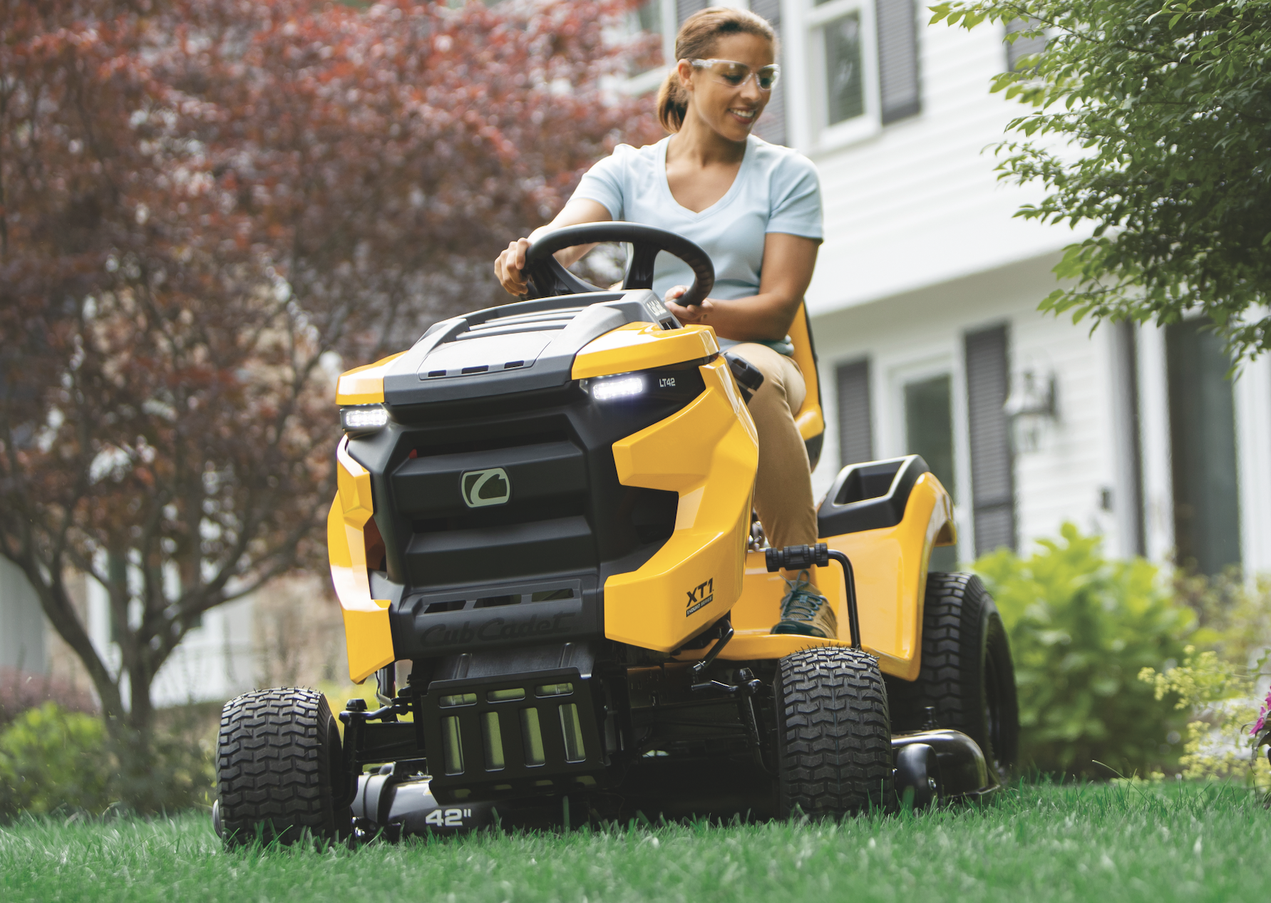

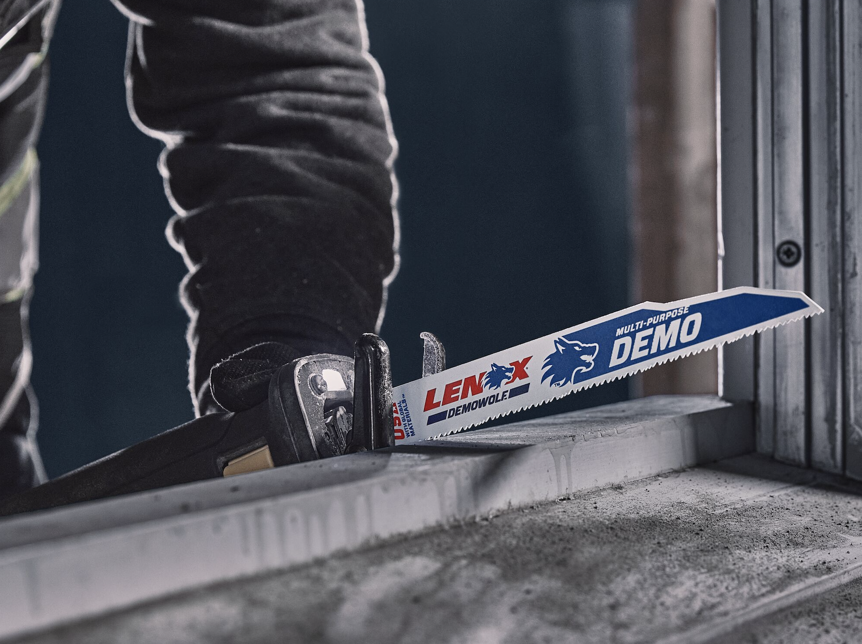

tools & Outdoor
Hiko Lai
Engineering Service
2024.xx.xx

Slide 2
Table of Contents
1
5
Natural Language processing overview
2
6
Train an Excel Agent
3
RAG
4

Slide 3
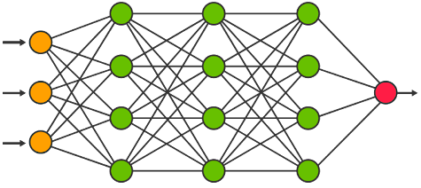
Natural Language processing overview
Layer II
Text generation
Foundation model: Models do specific task.
Image generation
Language translation
Layer I
Transformer: Neural networks, engines that transform a set of data to another form

Slide 4
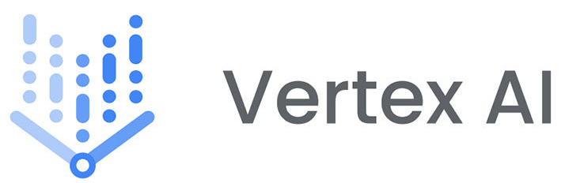
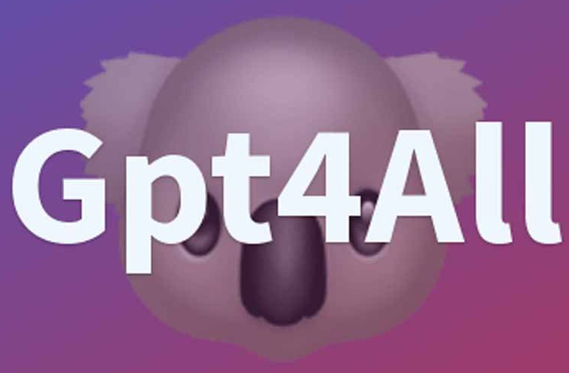
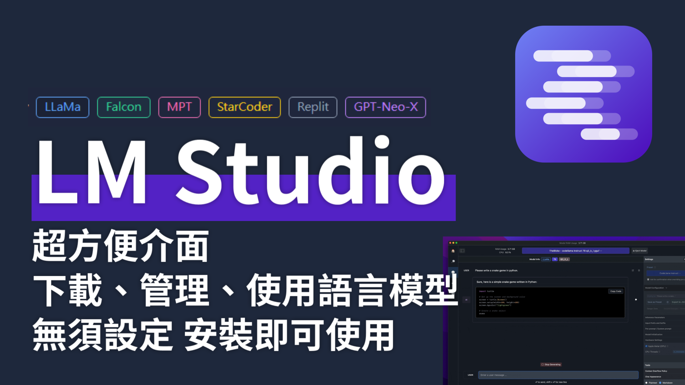











Natural Language processing overview
Layer IV
Model pool: Pool contain various models for app building
Layer III
Commercial-model: Models can interact with people
Layer II
Text generation
Foundation model: Models do specific task.
Image generation
Language translation
Layer I
Transformer: Neural networks, engines that transform a set of data to another form

Slide 5
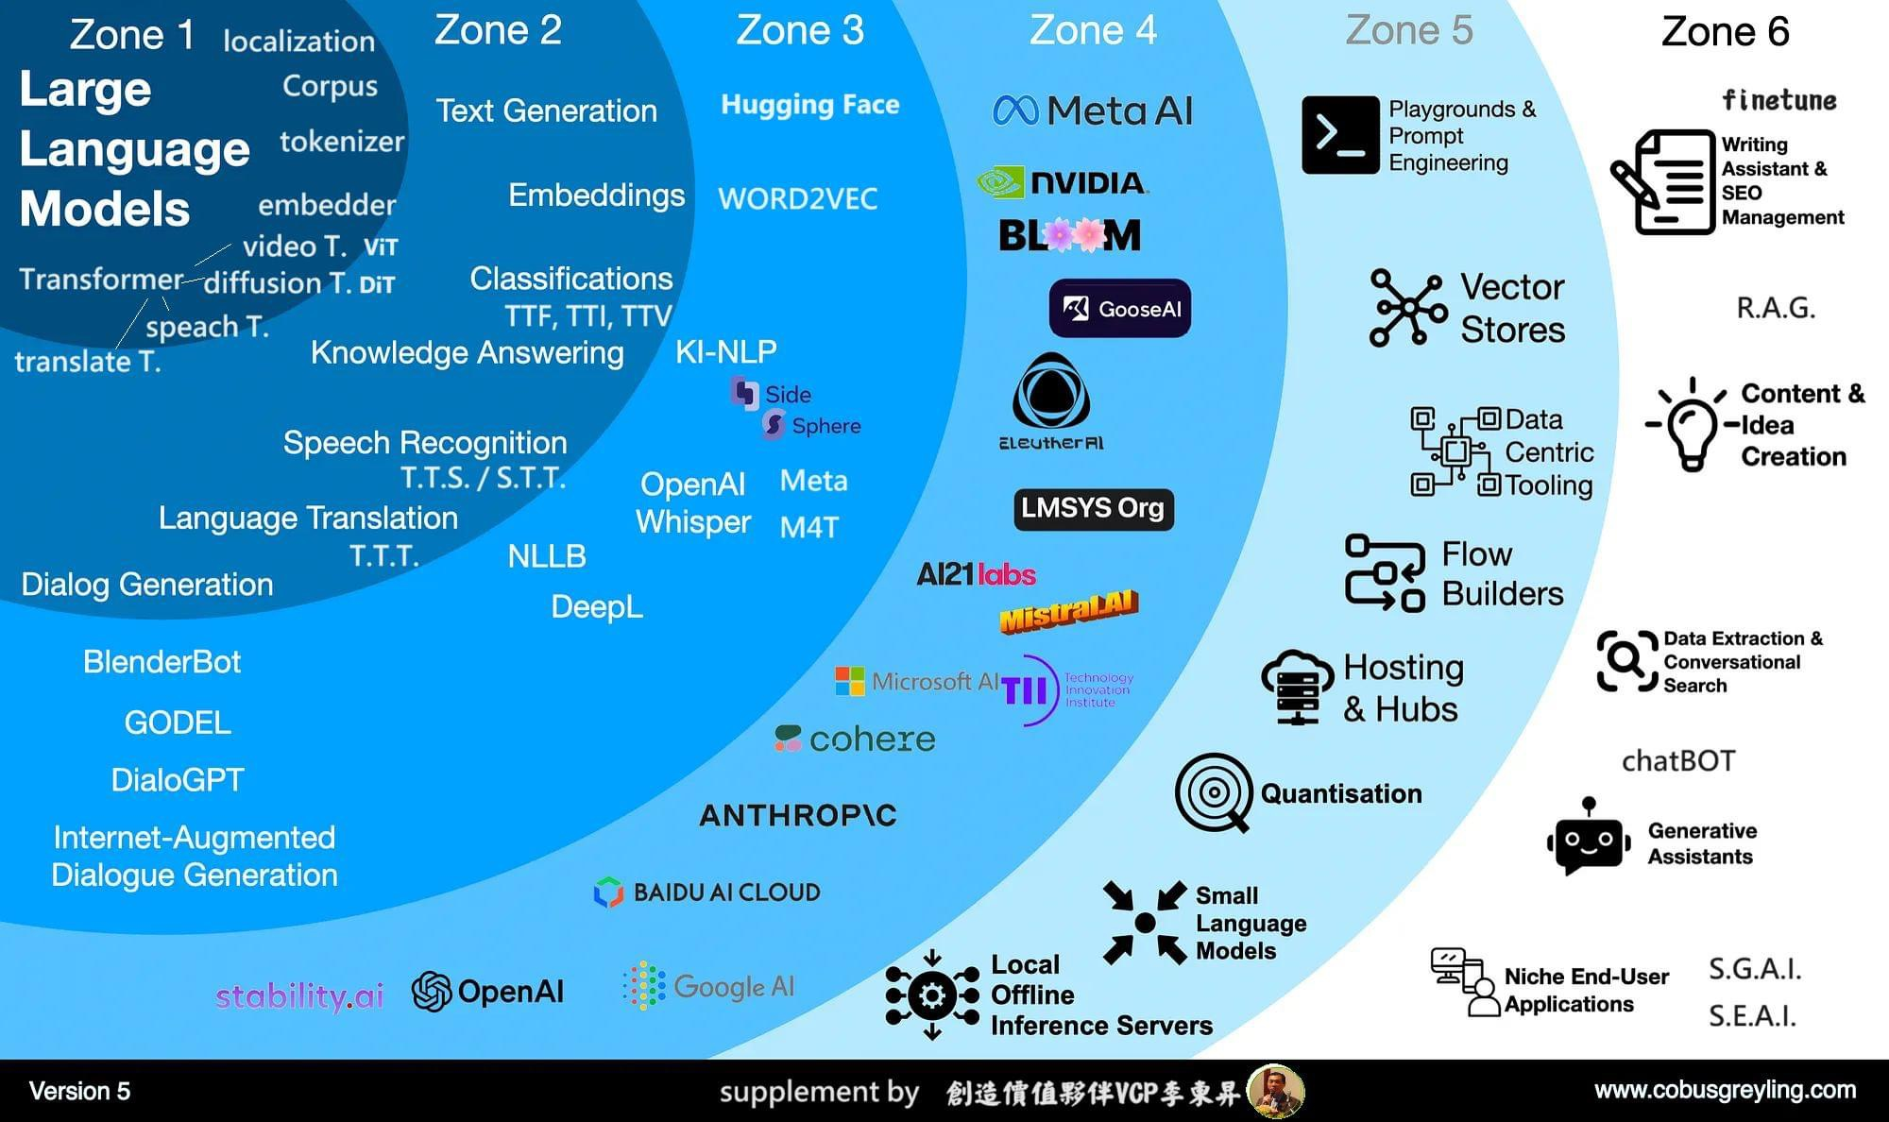

Natural Language processing overview
Layer V
AI apps: Functional AI contain 1 or more AI agent
Layer IV
Model pool: Pool contain various models for app building
Layer III
Commercial-model: Models can interact with people
Layer II
Text generation
Foundation model: Models do specific task.
Image generation
Language translation
Layer I
Transformer: Neural networks, engines that transform a set of data to another form

Slide 6







Natural Language processing overview
Secure
Can operate independently without internet.
Gen AI
Optimizer AI
Flexible
Interchangeable of both Gen AI model and dataset.
Localized action
Retriever AI
Iterate
for excellence
Reliable
Optimizer AI iterate to perform excellent result.
Database

Slide 8
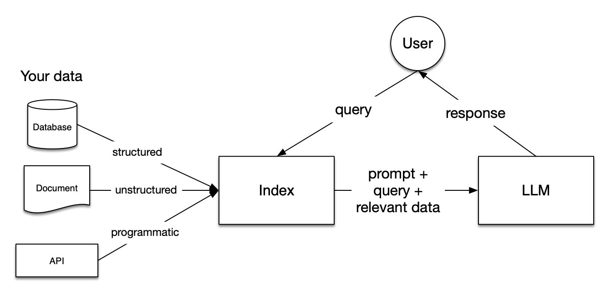



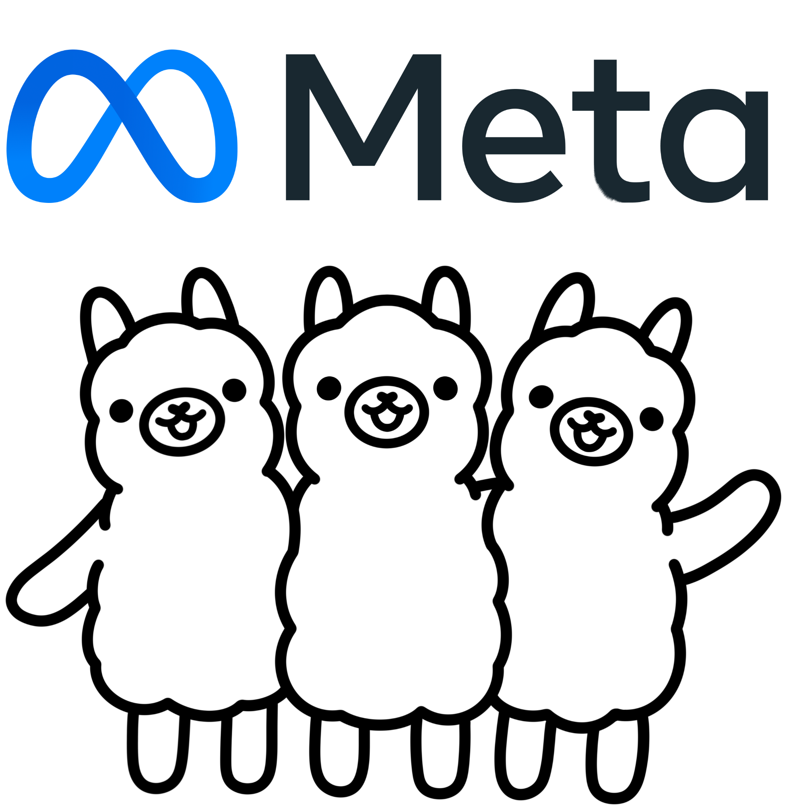





Retrieval Augmented
My data
Vector Database
Language Model
Milvus
LLaMA3
Weaviate
Qdrant

Slide 9
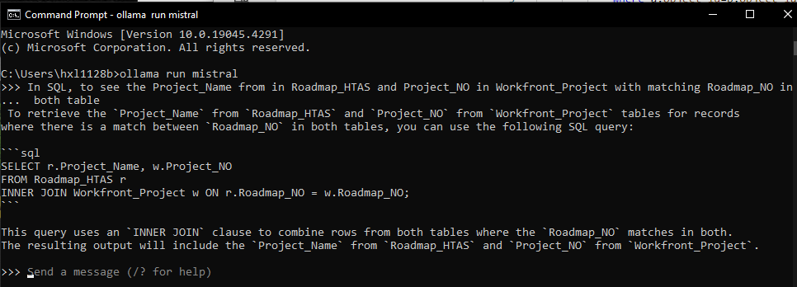
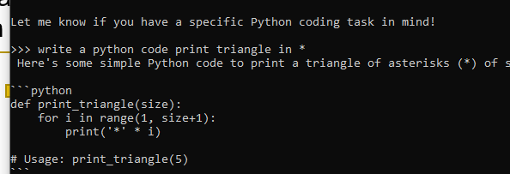

Retrieval Augmented
1.
Full Fine-tuning: Adjusts all parameters of the LLM using specific data
Local model retrain
2.
Prompt Engineering: Use prompt as 0-shot model input to guide its output
You are a python coder
3.
RAG (Retrieval Augmented Generation): Merges prompt engineering with database querying for context-rich answers

Slide 10


Slide 11





COMPANY
AI service
Model usage | Playground: Only Copilot accessible | Model Garden: Gemma from Google (others updating) | Bedrock: (連不進去) Amazon open-source model and others

